Slide 1
Debunking Arguments Against the Advanced Child Tax Credit
Lucy Smart
PPPA 6021
April 27, 2022

Slide 2
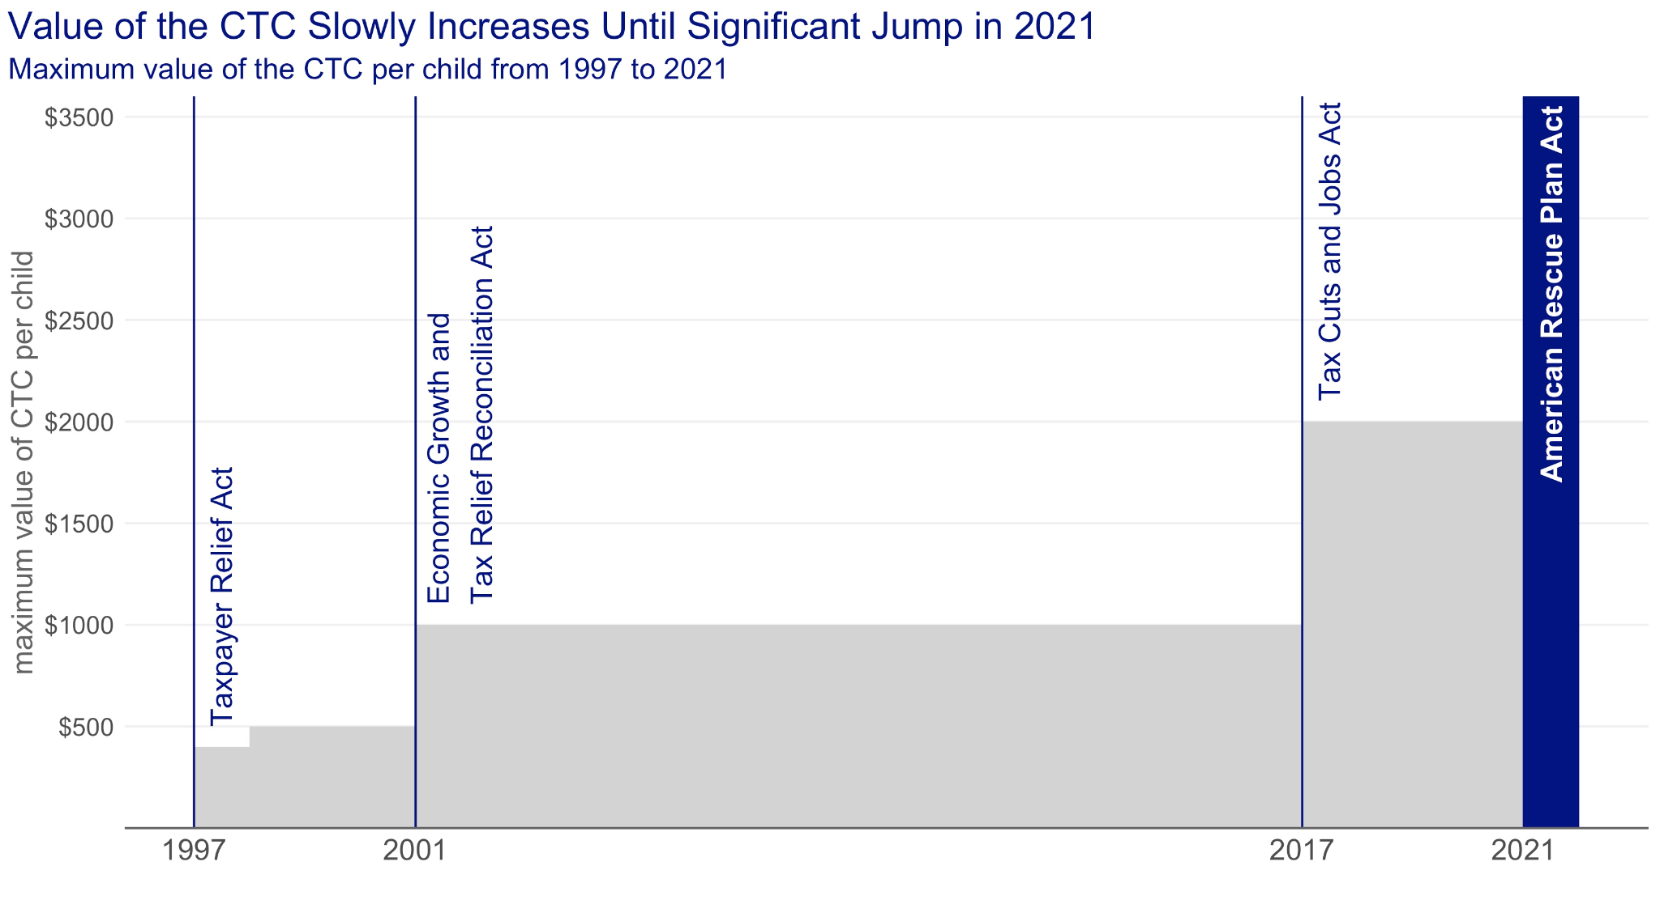
Source: “The Child Tax Credit: Legislative History.” Congressional Research Services, 2021

Slide 3
Policy Problem
ACTC payments stopped after December 2021 and the expanded credit was not renewed.
After one month of ACTC payments, 3 million fewer children were living in poverty.
The child poverty rate:
June 2021: 15.8%
July 2021: 11.9%
December 2021: 12.1%
January 2022: 17.0%
Researchers at the Urban Institute estimate that extending the ARPA’s changes to the CTC would reduce child poverty to 8.4% in just one year.

Slide 4
Why isn’t the ACTC being extended or made permanent?
“It discourages work”
“It’s too much money being given out in welfare”
“Parents will spend the money on drugs”

Slide 5
The ACTC did not reduce employment levels.

Slide 6
Source: “Civilian unemployment rate.” Bureau of Labor Statistics, 2022

Slide 7
Source: “Civilian unemployment rate.” Bureau of Labor Statistics, 2022

Slide 8
Source: “Civilian unemployment rate.” Bureau of Labor Statistics, 2022

Slide 9
Monthly ACTC payments are less than the average household spends on food.

Slide 10
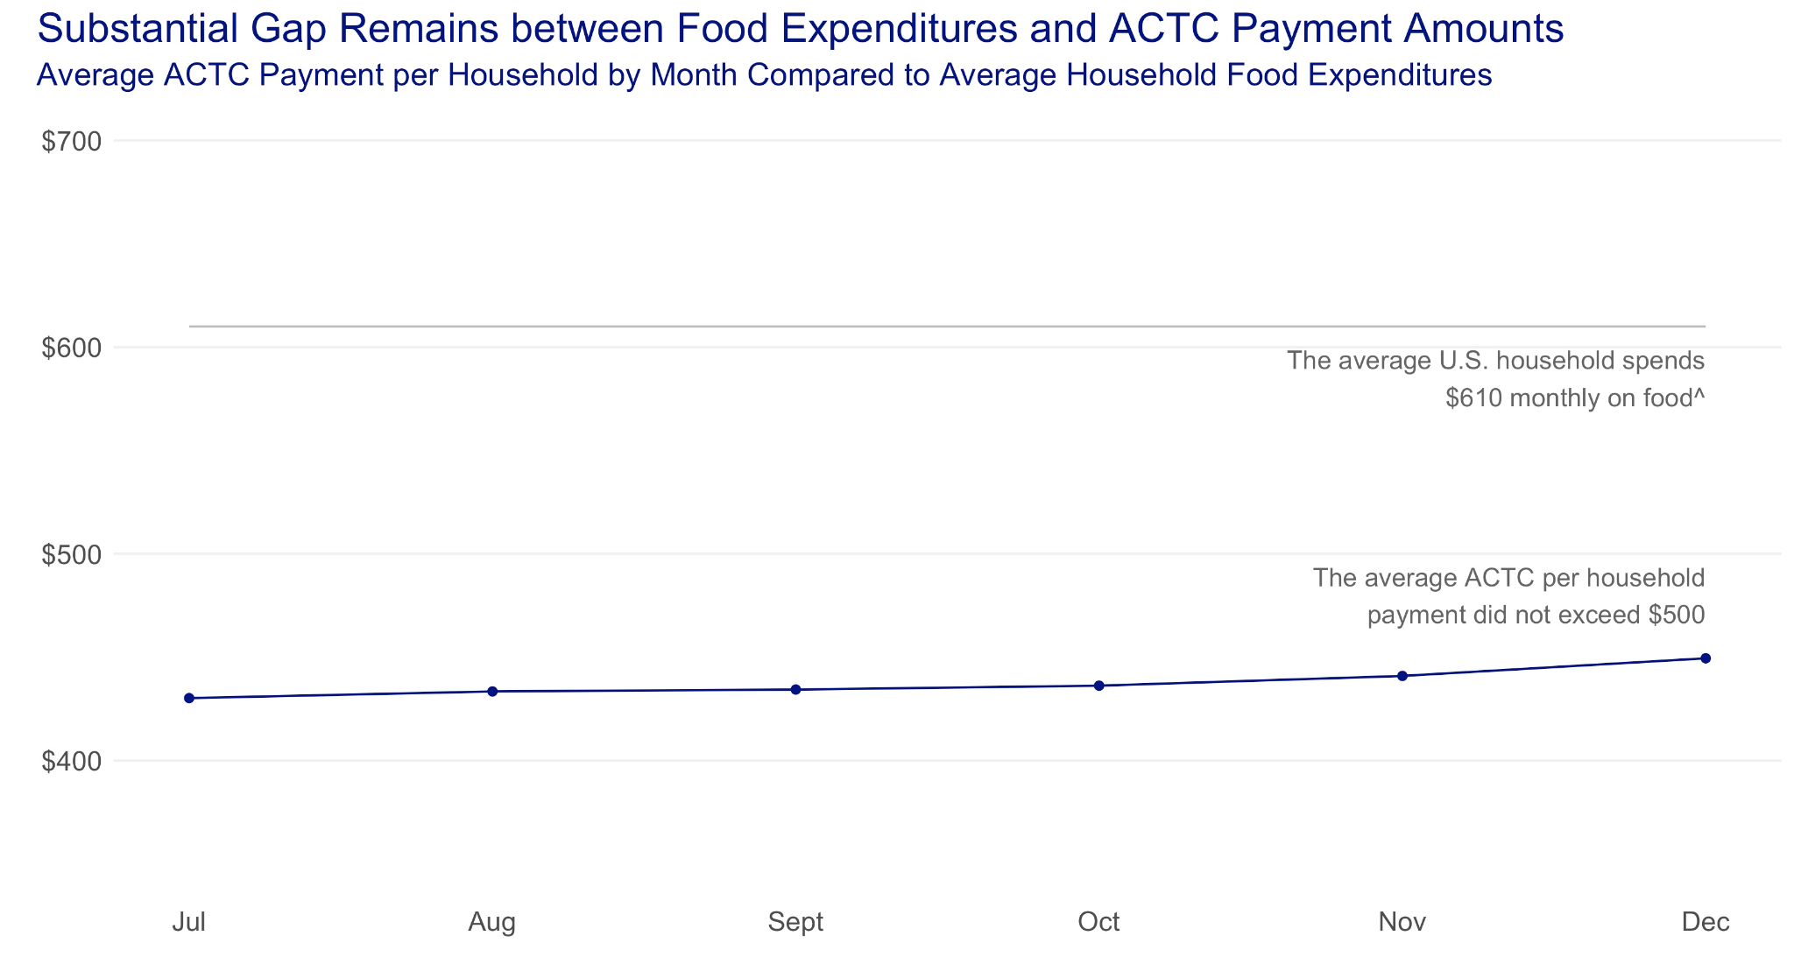
Source: “Advance Child Tax Credit Payments Disbursed each Month, by State.” U.S. Department of the Treasury Office of Tax Analysis, 2022.

Slide 11
Households spent ACTC payments on basic needs.

Slide 12
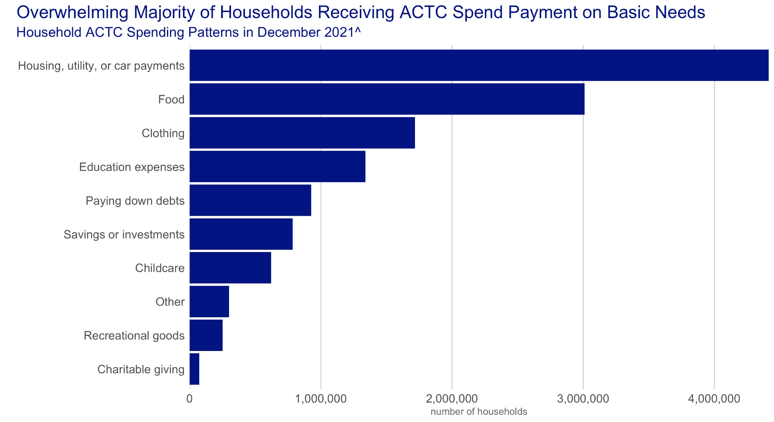
Source: “Week 40 Household Pulse Survey: December 1 – December 13.” U.S. Census Bureau, 2021.

Slide 13
Policy Recommendation
Make the 2021 Advanced and Expanded Child Tax Credit permanent to effectively reduce child poverty in the U.S.
Worth up to $3,600 per child, including 17-year-olds.
Fully refundable.
Available in monthly or yearly payments.

Slide 14
Questions?

