Slide 1
ACCESS TO ELECTRICITY: MEASURING THE IMPACT OF POWER AFRICA
LYDIA J. HOLLINGSWORTH
PPPA 6021: DATA VISUALIZATION
SPRING 2022

Slide 2
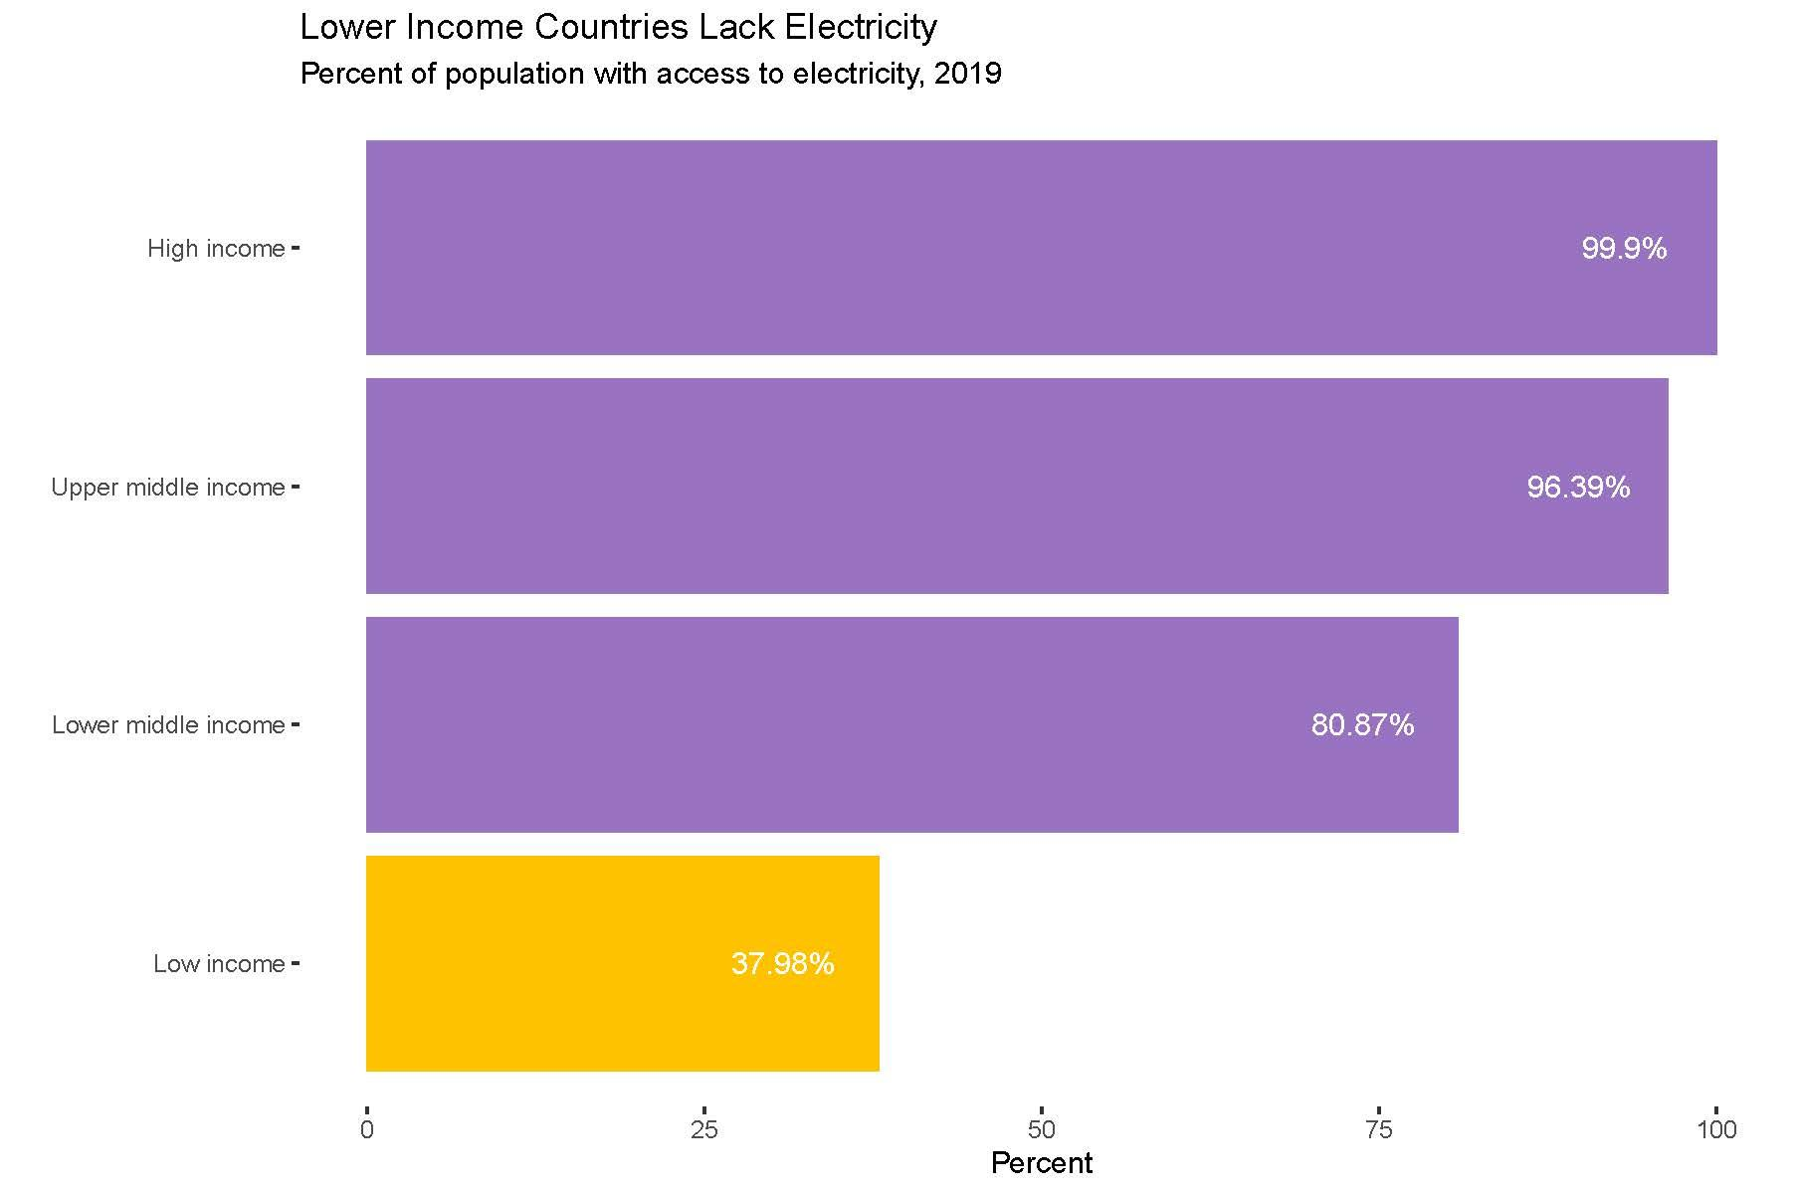
WHO HAS ACCESS TO ELECTRICITY?
There is a clear correlation between poverty and access to electricity
As the poorest continent, only slightly more than 50% of Africa’s population has access to electricity
Source: World Bank

Slide 3
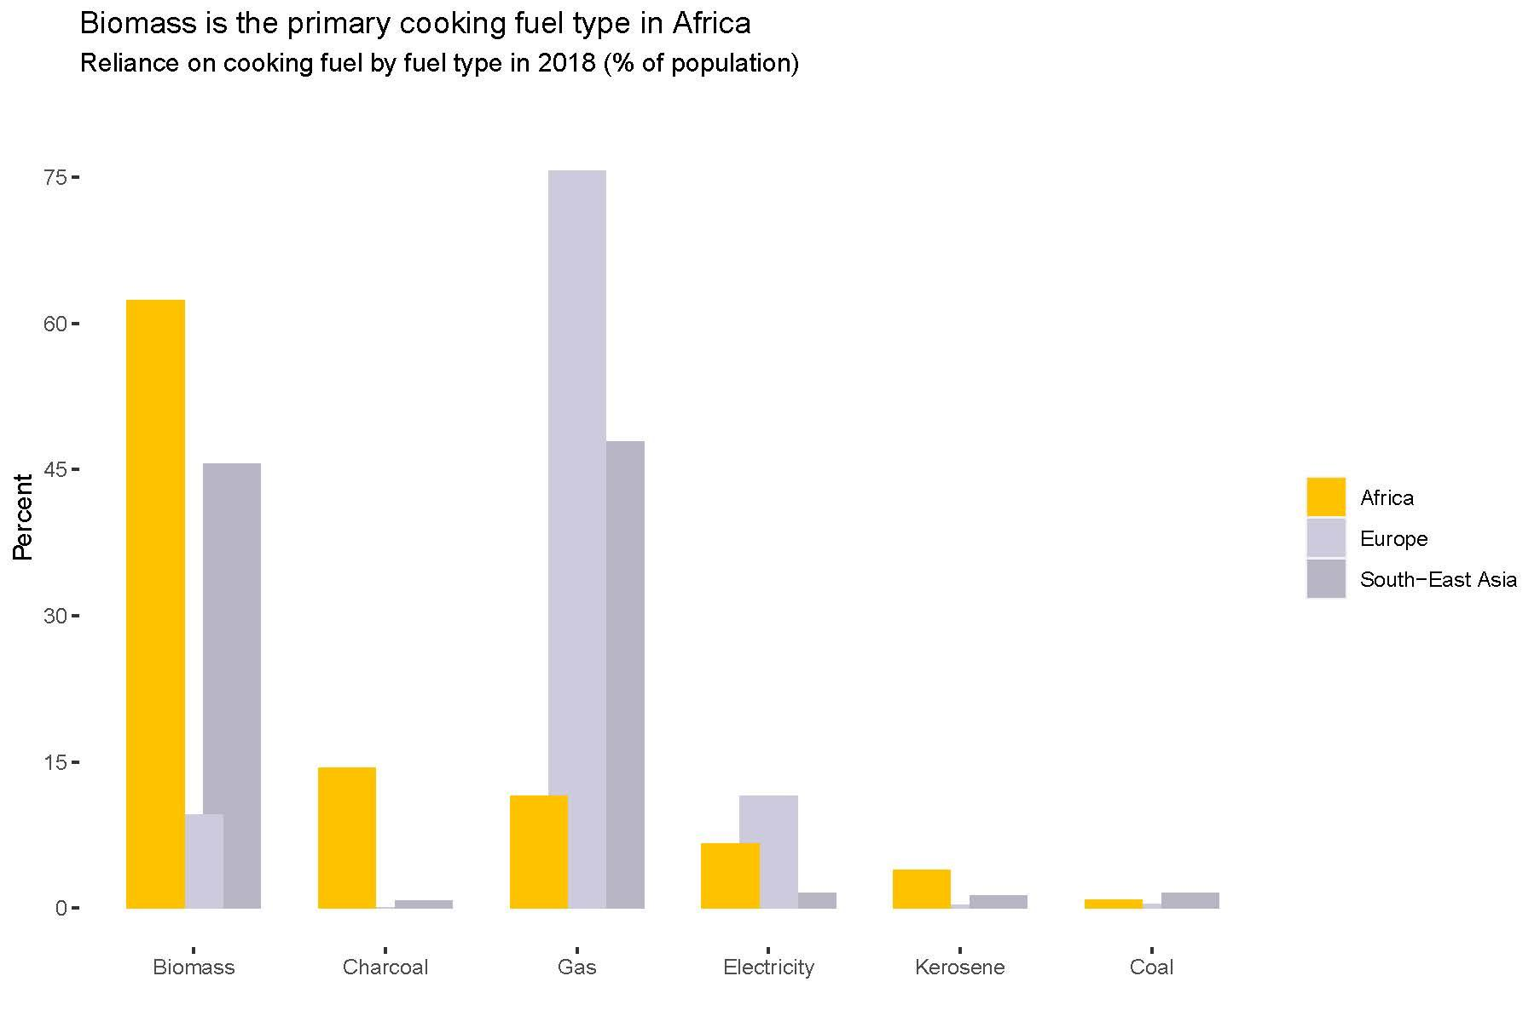
HOW IS AFRICA POWERING ITSELF?
Africa is heavily reliant on biomass for essential activities, such as cooking
To produce power, biomass (wood, plant-based material) is burned for fuel, which contributes to health issues and pollution
Source: World Health Organization

Slide 4
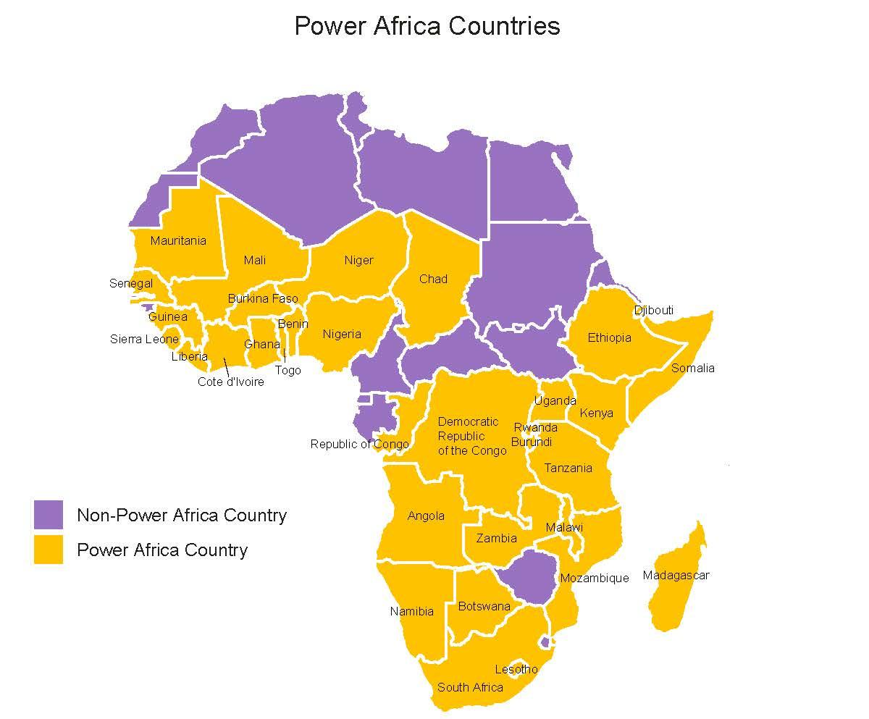
WHAT IS POWER AFRICA?
USAID has responded to Africa’s power deficit by aiming to provide 30,000 MW of cleaner, more reliable energy sources
Launched in 2013, Power Africa has aided 30+ African countries
Source: USAID

Slide 5
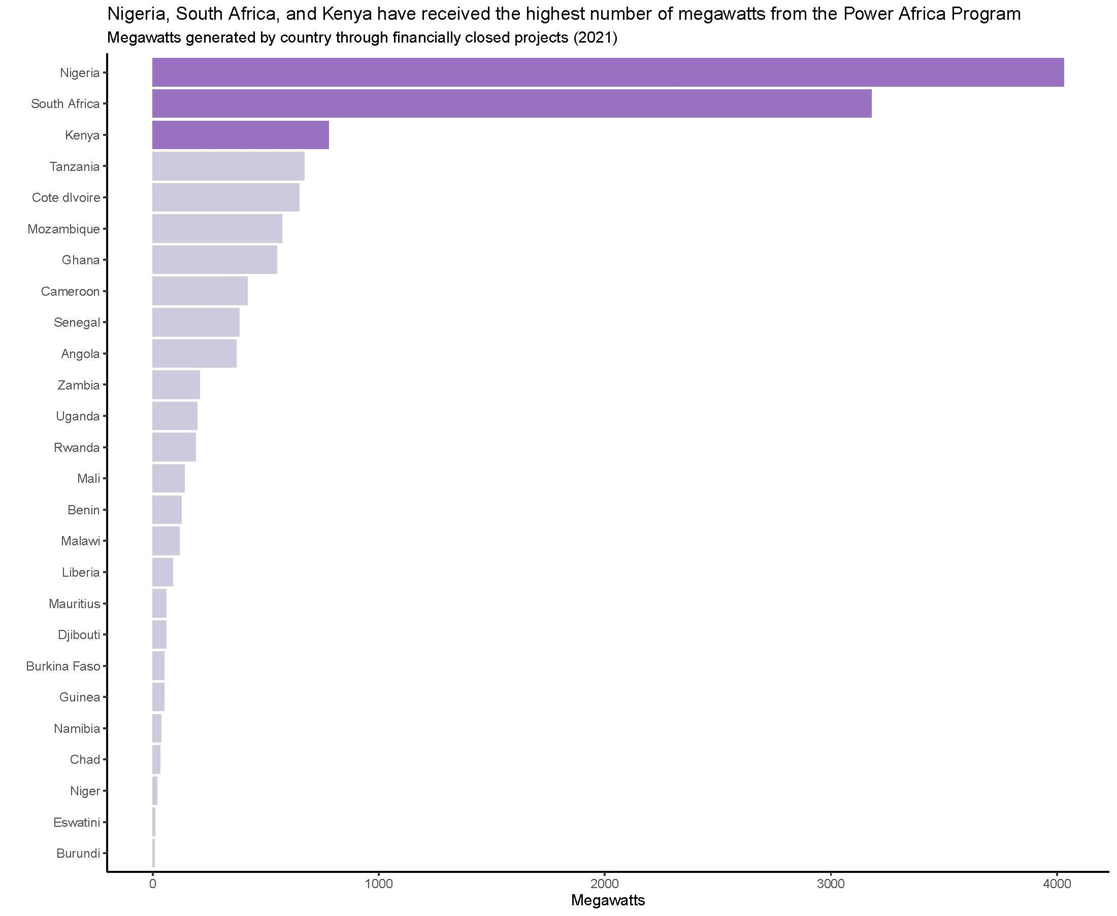
WHAT ARE THE COUNTRIES RECEIVING?
For perspective: a typical US home uses 7.2 million megawatt hours of electricity each year
Nigeria, South Africa, and Kenya are also the most populous countries in the continent
Source: USAID

Slide 6
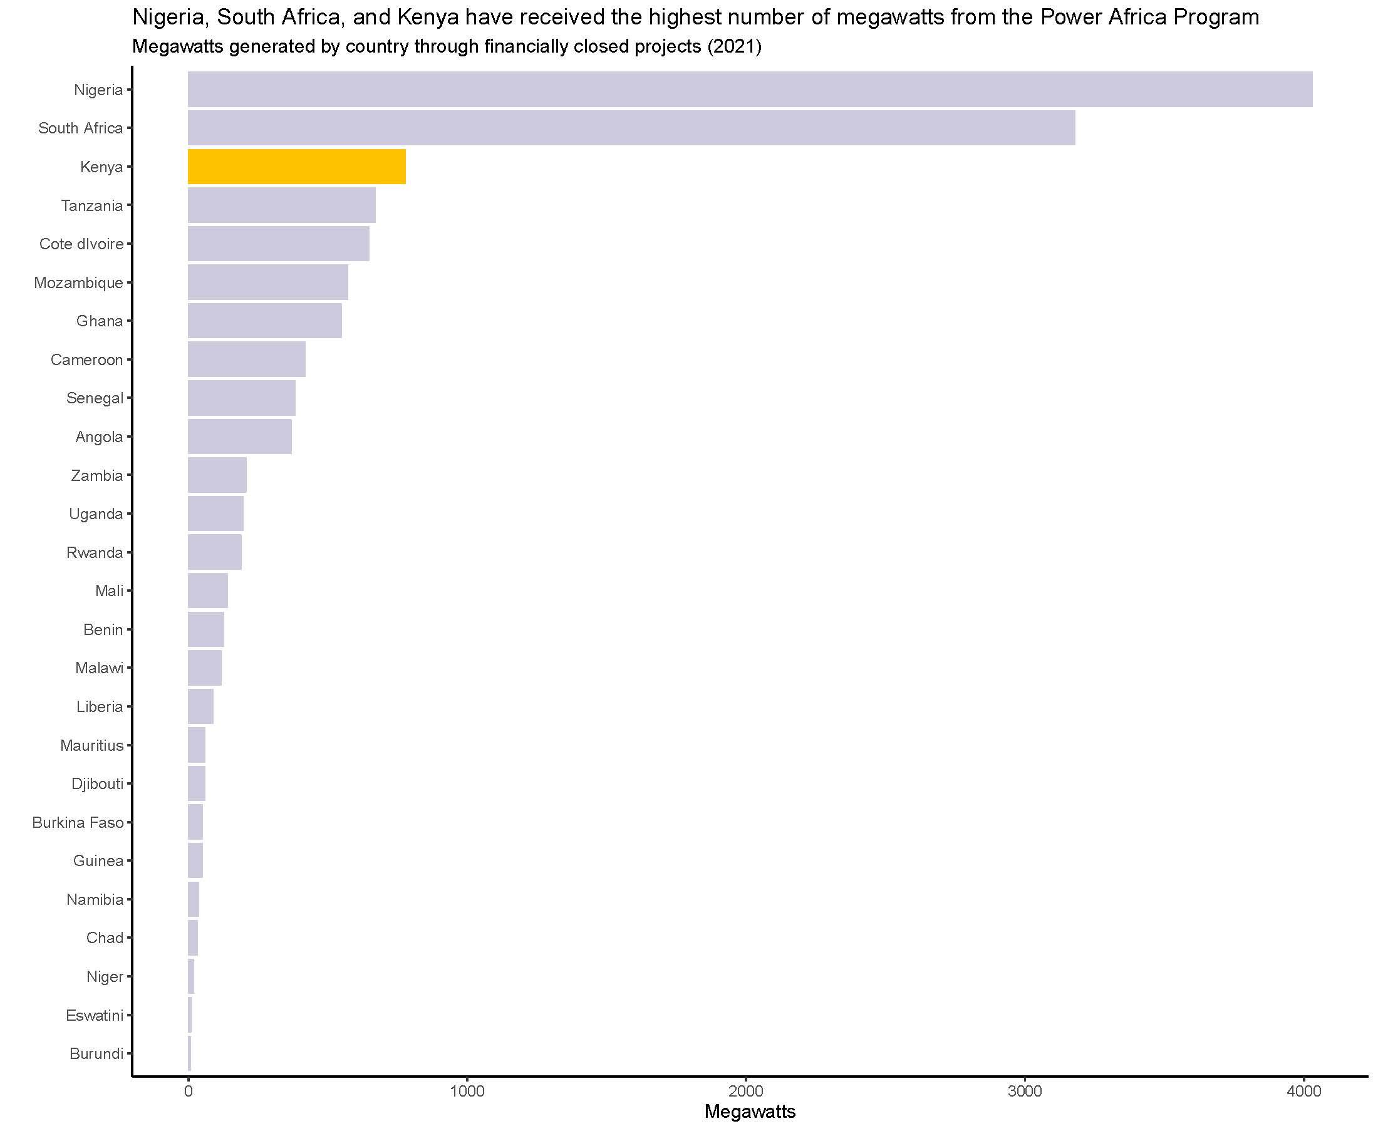
WHY KENYA?
Kenya has programs that are focused on:
Developing clean power sources (wind power projects)
Promoting more reliable lighting and cooking systems for underserved communities
Hiring women to inform about and sell clean cooking systems
Source: USAID

Slide 7
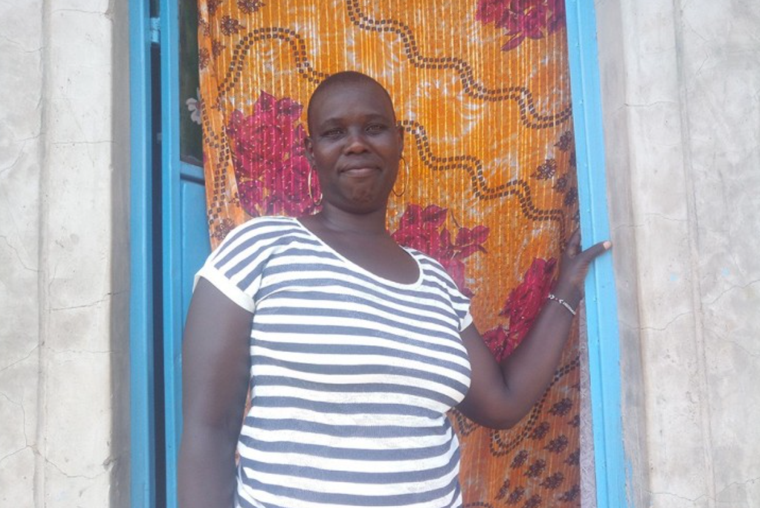
WHAT DO WE HOPE TO SEE?
INDICATORS
Decrease in reliance on biomass for cooking
Increase in female employment
Increase in clean energy reliance

Slide 8
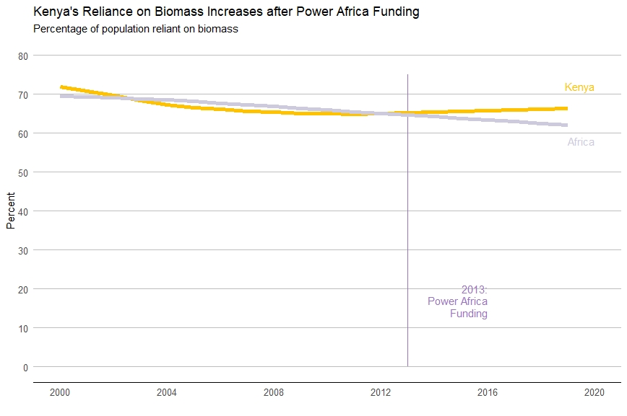
1. HOW HAS RELIANCE ON BIOMASS CHANGED?
Power Africa has not helped to decrease Kenya’s reliance on biomass
Source: WHO

Slide 9
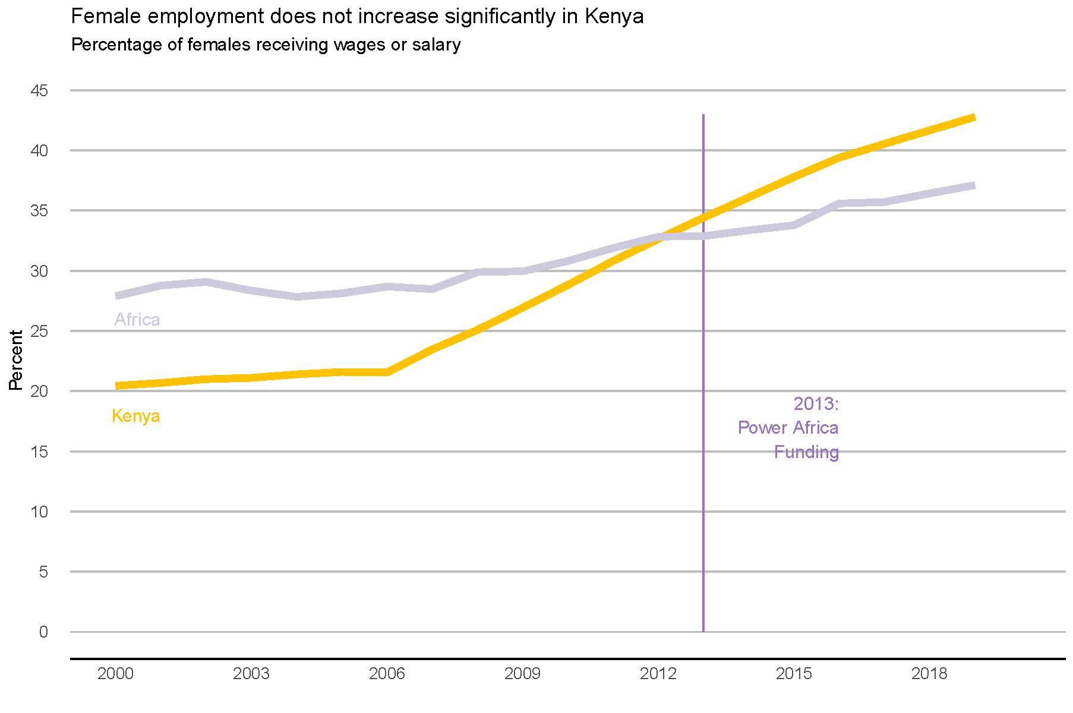
2. HOW HAS FEMALE EMPLOYMENT CHANGED?
Female employment in Kenya has increased steadily since 2006 and surpassed Africa in 2011
Source: World Bank

Slide 10
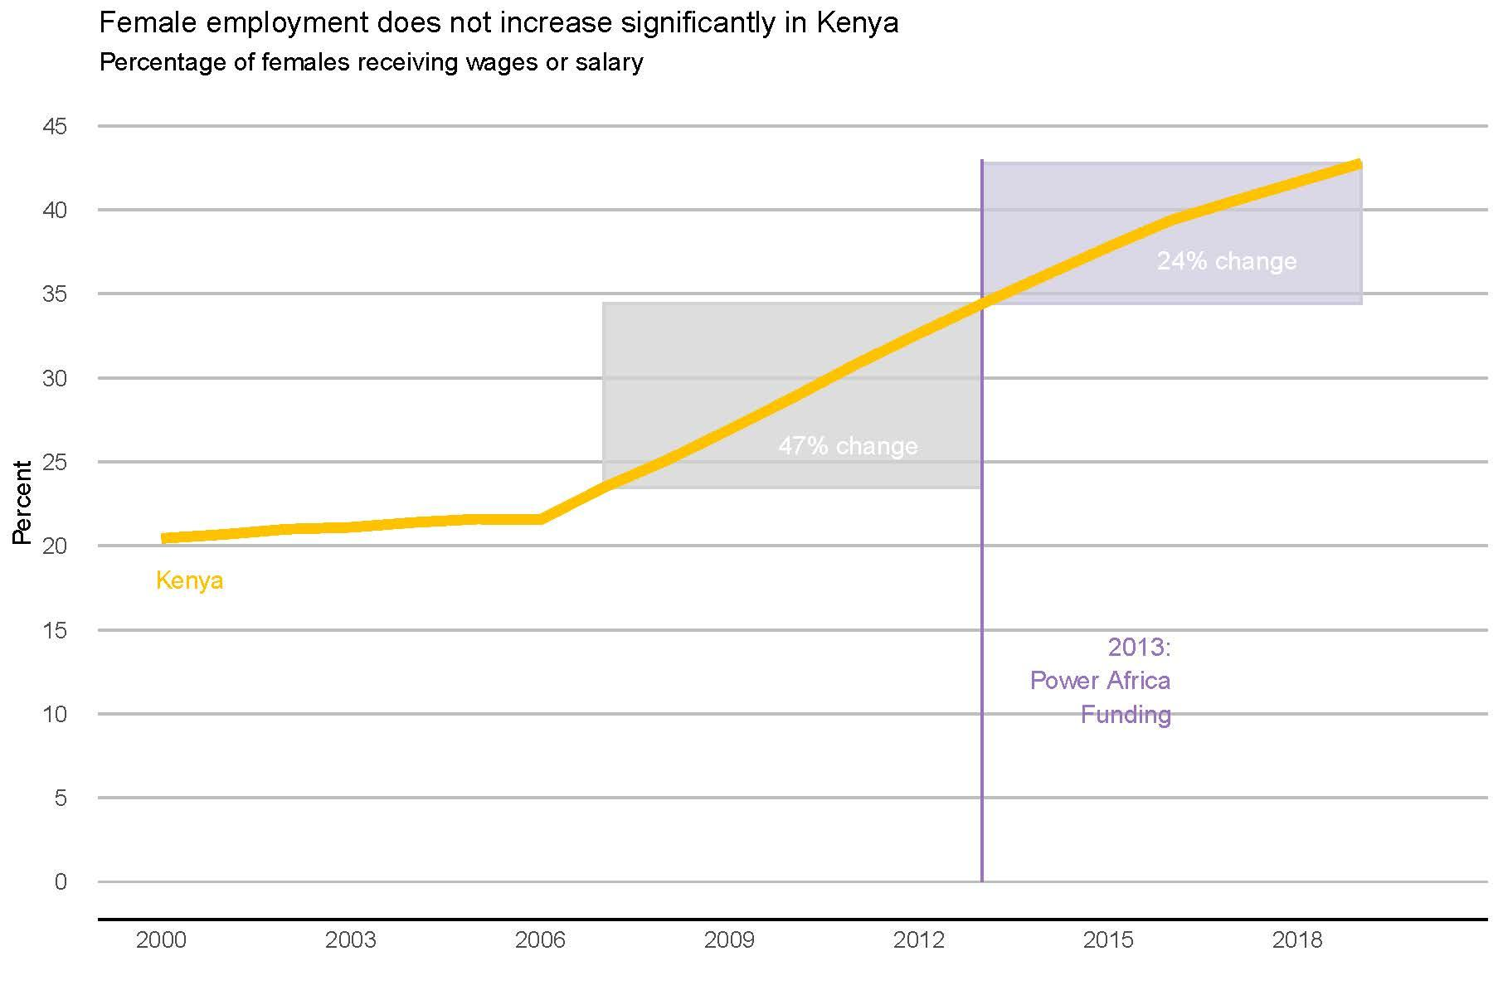
2. HOW HAS FEMALE EMPLOYMENT CHANGED?
Female employment in Kenya has increase steadily since 2006 and surpassed Africa in 2011
But the percent change decreased after 2013 when Power Africa funding began
Source: World Bank

Slide 11
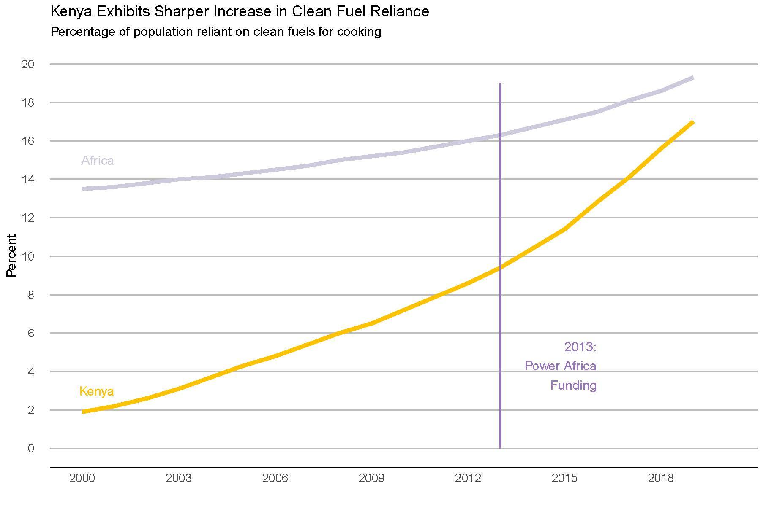
3. HOW HAS RELIANCE ON CLEAN ENERGY CHANGED?
Kenya quickly catches up to Africa in its reliance on clean energy
Source: WHO

Slide 12
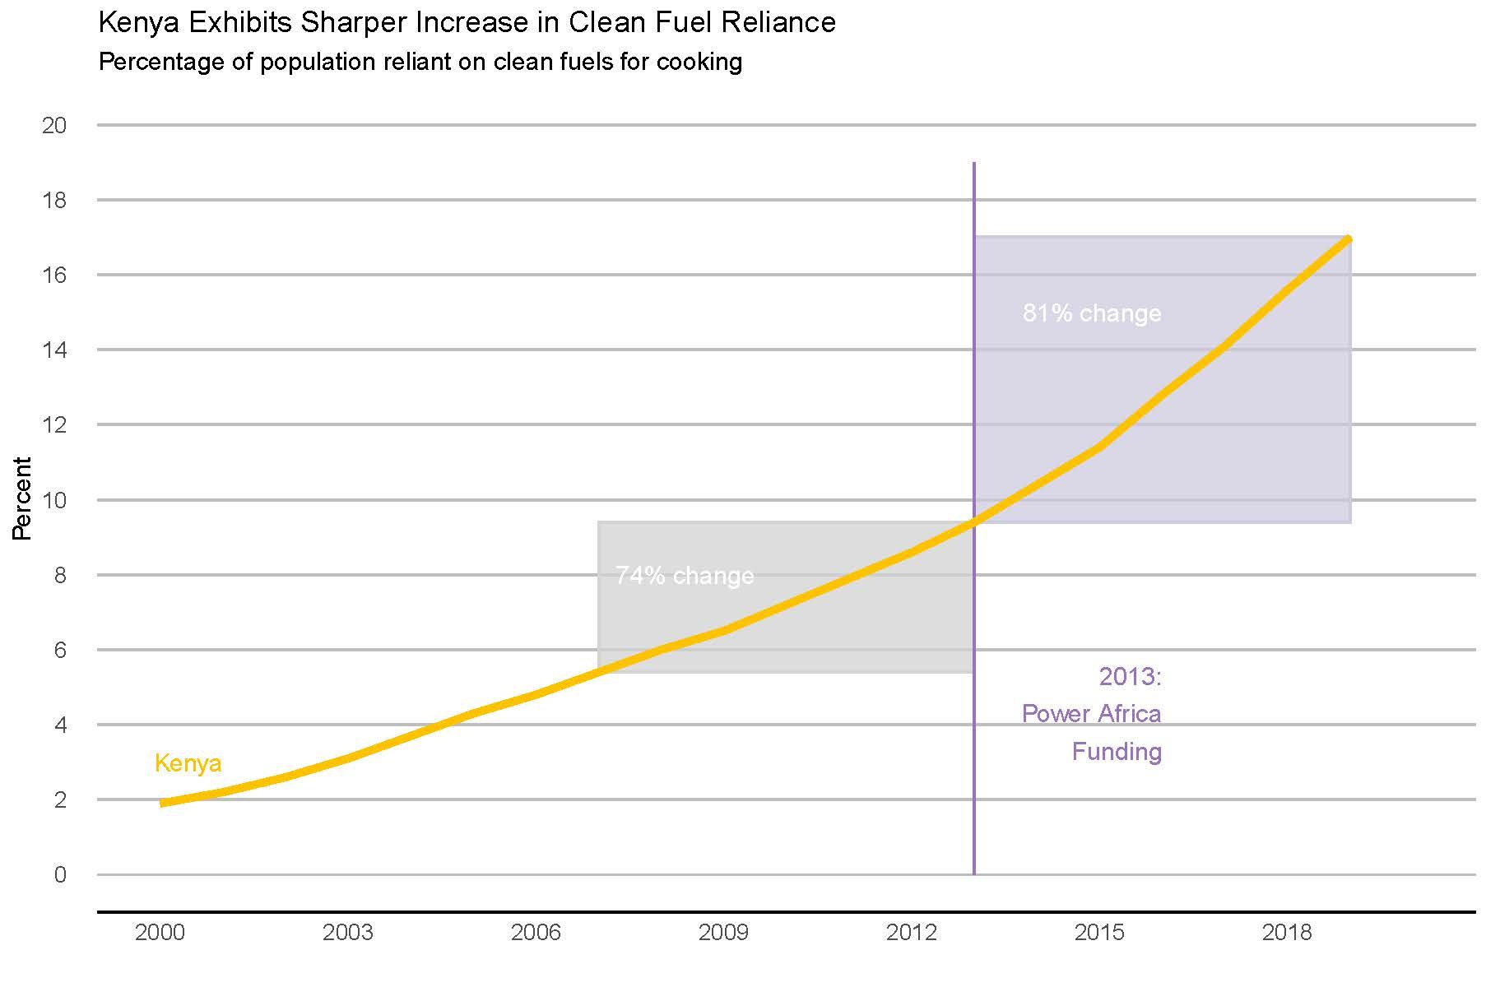
3. HOW HAS RELIANCE ON CLEAN ENERGY CHANGED?
Kenya quickly catches up to Africa in its reliance on clean energy
There was a higher % change in clean energy reliance after Power Africa Funding began!
Source: WHO

Slide 13
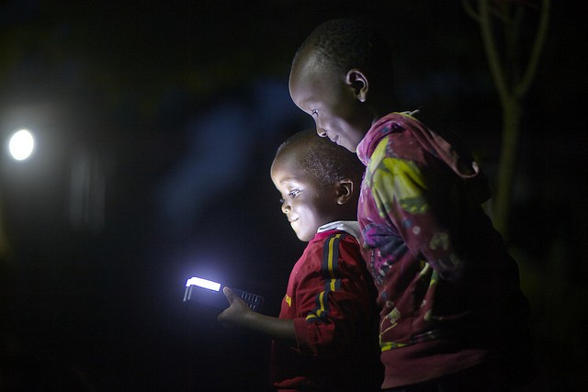
IS THE POWER AFRICA PROGRAM IMPACTFUL?
INDICATORS
Decrease in reliance on biomass for cooking
Increase in female employment
Increase in clean energy reliance
CONSIDERATIONS
Many external factors that are not accounted for
Indicators remain on a macro scale, while impact may be more anecdotal
Program will continue for at least 8 more years

Slide 14
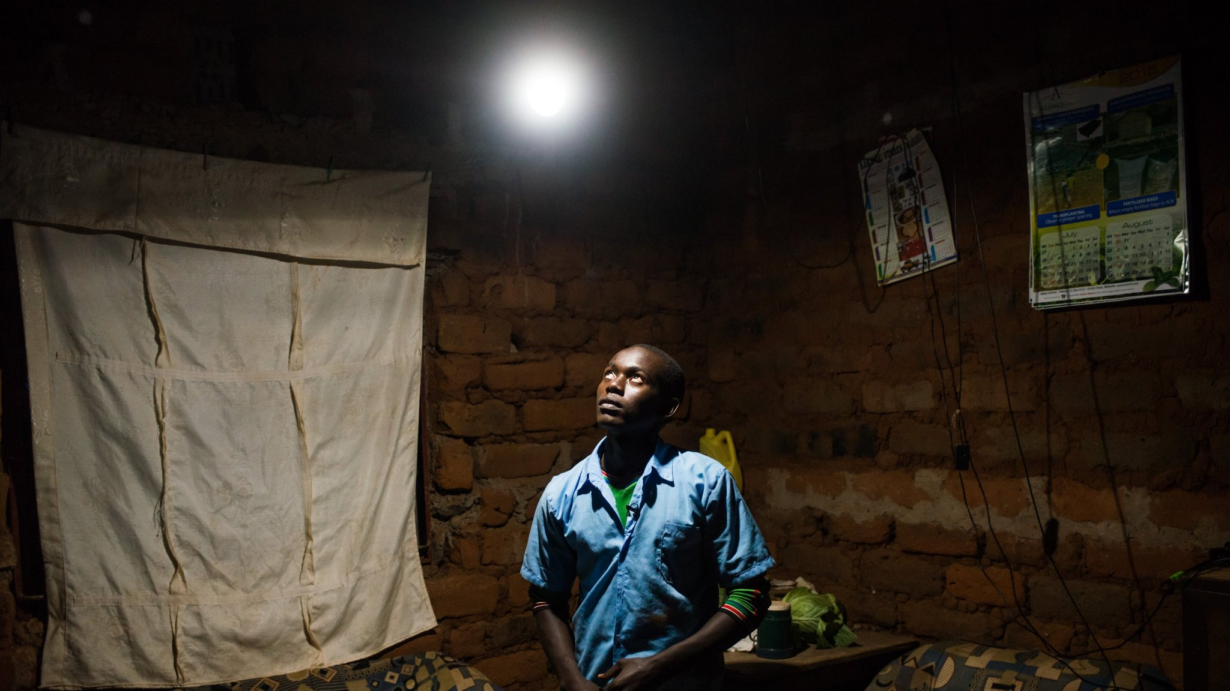
QUESTIONS?

