Slide 1
“Should Airbnb rentals be subject to hotel taxes and regulations?”
Michael A. Horneffer

Slide 2
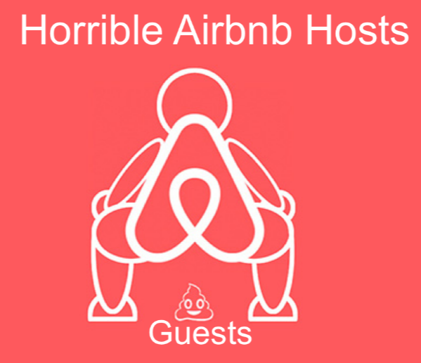
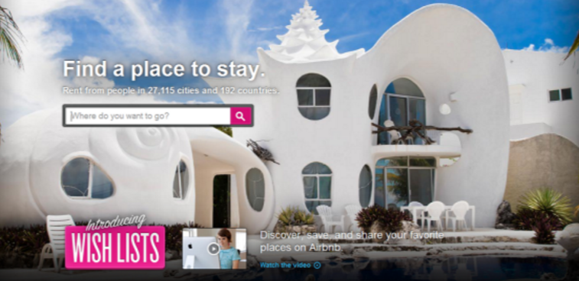
The Hotel Tax and some background…
Massachusetts want to extend the hotel tax to short term rentals (companies like Airbnb)
The hotel tax = an occupancy tax and is a consumer burden
Current market seems unfair to legislation advocates. Also, there is a perceived need for additional regulation:
The legislation is actually supported by the Airbnb industry lobby – why?
- Taxes mean legitimacy
Taxes and increased regulation are also seen a beneficial to the communities where Airbnb and other similar businesses operate

Slide 3
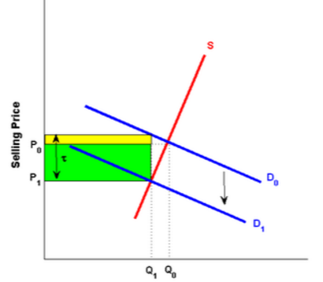
Implications
Tax incidence
-Demand for lodging is generally more elastic
-Burden is on the bnb sellers
Spillover
-Tax advocates also assert that “big investors [are] buying up buildings and using them for Airbnbs.”
- In certain areas, in the long run, this may increase the price of housing
Copyright: economicsonline.co.uk

Slide 4
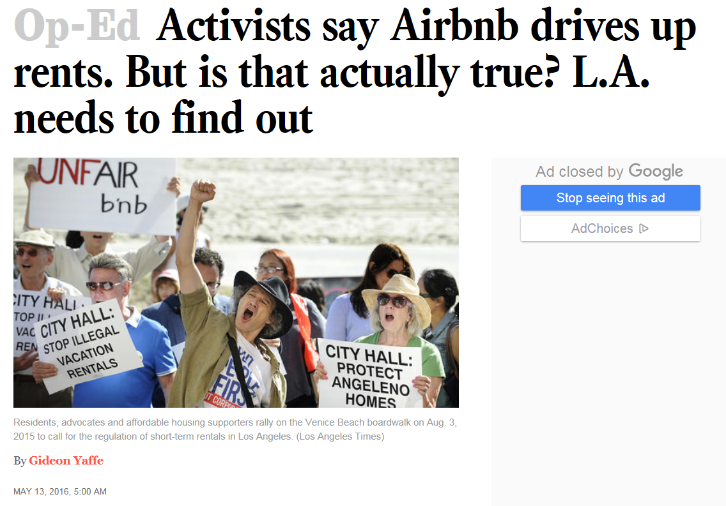
“Further, restricting Airbnb rentals could have the perverse effect of punishing victims of the rental crisis. Many Airbnb hosts are renters who manage to pay their inflated rents on time thanks to income generated by subletting part of their space through Airbnb. The proposed ordinance, which would permit only owners, not renters, to host through Airbnb, could force many people currently renting apartments in the city to relocate.
Before establishing potentially harmful rules, the city should slow down and examine all the pros and cons of limiting Airbnb rentals. Perhaps it's time the city commissioned a study of its own.”

Slide 5
Questions?

