Slide 1
Tired of travel fees? Here’s a charge you may be unaware of
by The Associated Press

Slide 2
Summary
Ride services charged a fee for entering airport pickup areas
Taxi
Ride share
Shuttle bus
Rentals
Surcharge vary across airports
San Francisco - $5 (taxi); $3.85 (Uber/Lyft)
Washington DC, Reagan National - $3 (taxi); $4 (other services)
In 2015, fees added up to $183 million
Why? Maintenance
Notes:
Why?
Maintenance of roads
Staff to direct traffic
New waiting areas

Slide 3
Application from Class
Tax incidence rule 1:
statutory incidence ≠ economic incidence
Statutory incidence: falling on producers (i.e. ride service providers)
Economic incidence: mostly falling on travelers
Providers passing fee on to travelers
Traveler cannot easily avoid the charge
Demand curve inelastic, fee applies to most services

Slide 4
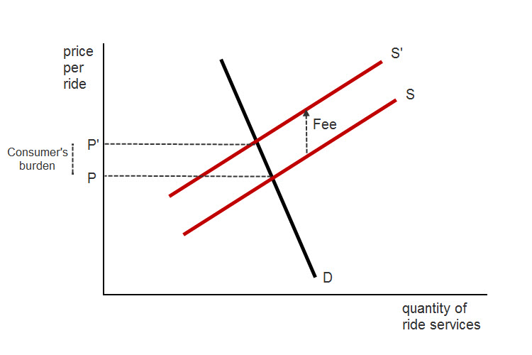
Travelers’ Inelastic Demand Curve
Notes:
Note: The demand curve is not perfectly inelastic because travelers could catch a ride from a friend, family member, or use public transit.

Slide 5
Exception
Chicago airports charge low fees
Substitutes available
Chicago Transit Authority state 18,000 people use train to get to the airport
Demand curve elastic

Slide 6
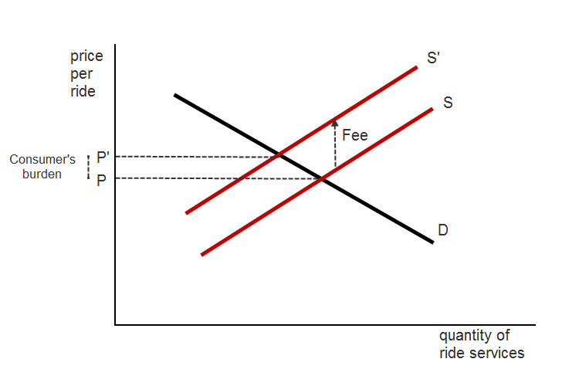
Travelers’ Elastic Demand Curve

