Slide 1
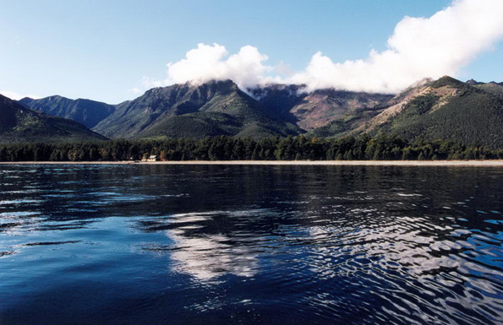
Vast and Pristine, Russia’s Lake Baikal Is Invaded by Toxic Algae
Sara Linder
11.22.2016
PPPA 6017
Notes:
Photo cred: http://magic-ays.com/Lake/LakeBaikal.htm

Slide 2
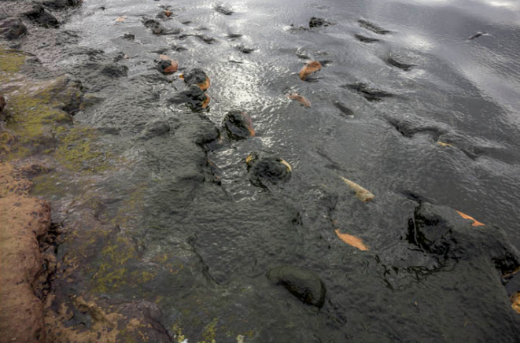
Lake Baikal
Located in Russia, bordering Siberia
World’s oldest, deepest freshwater lake
Previously believed to be the world’s cleanest lake
Home to more than 3,700 species
half of which are found nowhere else in the world
Holds 20% of the planet’s unfrozen freshwater.
- According to New York Times article
Notes:
Lake Baikal stats provided in NYT article:
http://www.nytimes.com/2016/11/15/science/lake-baikal-russia-algae.html?_r=0

Slide 3
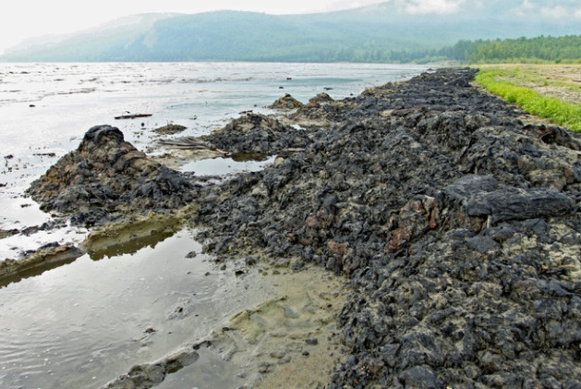
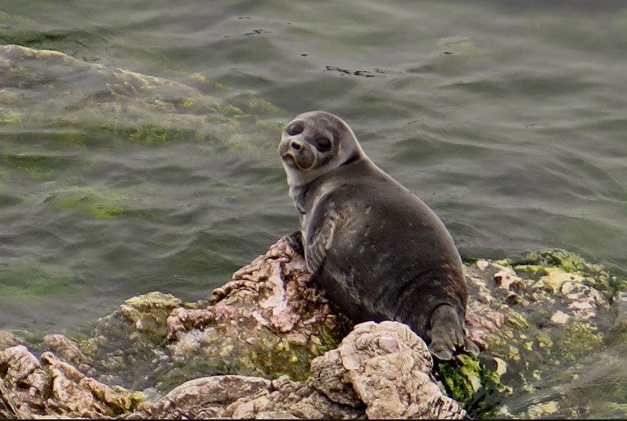
Summary
Summary
Mass algae blooms have been discovered along its beaches.
Resulting from:
inadequate waste water treatment
illegal dumping of sewage waste
runoff of fertilizers and other pollutants
growth of tourism
Lake affected by combination of:
climate change, pollution and human activity
Notes:
Sludge – NYT Article - http://www.nytimes.com/2016/11/15/science/lake-baikal-russia-algae.html?_r=0
Sea lion - http://phys.org/news/2015-10-world-largest-freshwater-lake-threat.html

Slide 4
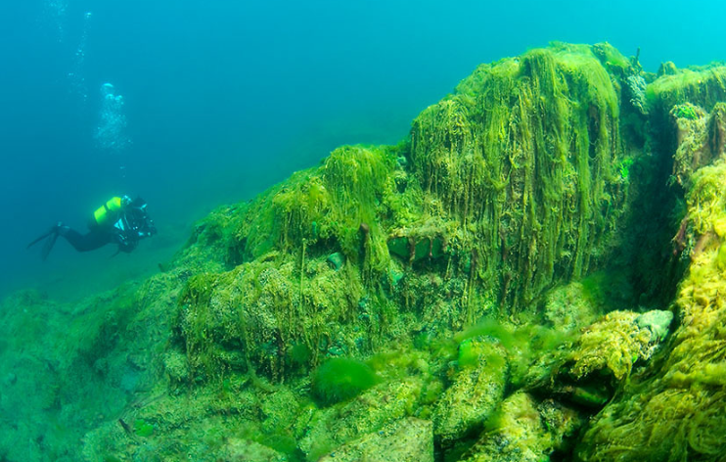
Public Goods & Externalities
Lake Baikal is an impure public good
rival, not excludable
Sewage/ wastewater treatment
Impact of influx of untreated sewage → mass algal blooms:
Negative externalities:
Drinking water impacted
Visual enjoyment loss
Public health risk including consumption of seafood
Ecological impact
Impact on tourism industry
Notes:
Photo cred: http://news.nationalgeographic.com/2015/11/151113-lake-baikal-green-slime-algae-photos-water-quality-science/

Slide 5
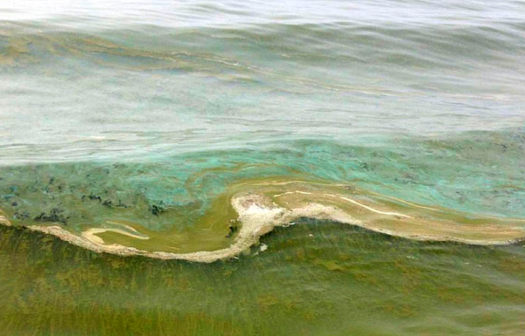
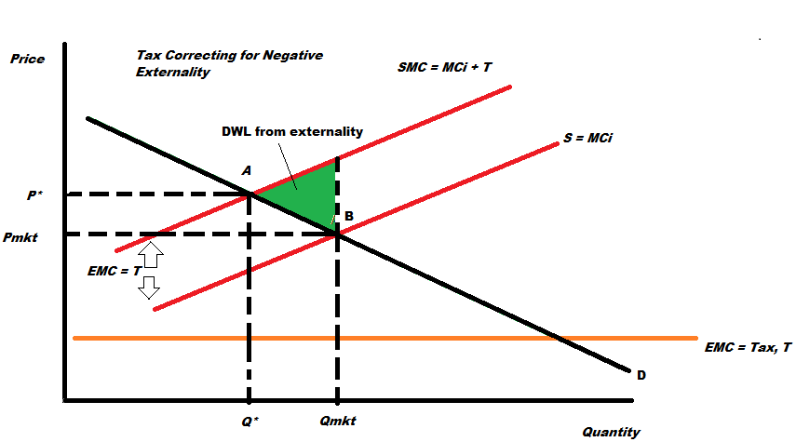
Fixing Externalities
Researchers called on gov. to reform sewage facilities
But disagreement on cause of problem
Pollution externalities from private industries including:
agricultural fertilizer run-off
Russian railroads discarding industrial waste in the sewage system
Notes:
Pic Cred- http://siberiantimes.com/ecology/casestudy/features/f0247-if-you-love-baikal-become-a-peoples-scientist-to-save-it-from-stinking-algae/

Slide 6
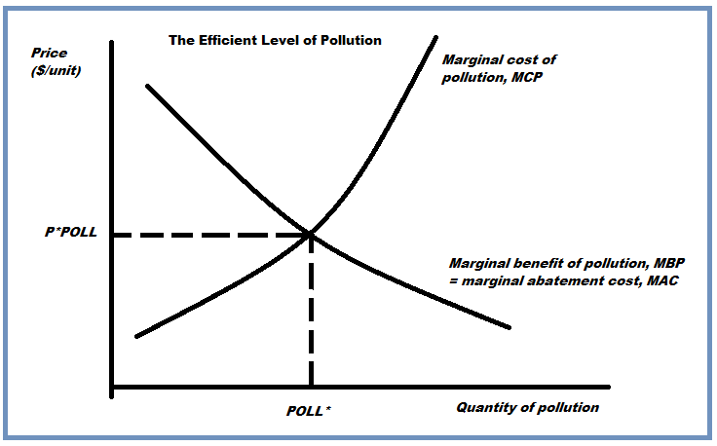
Mongolia Hydroelectric Dams
Plan to build 8 dams to support energy goals
Negative externalities
Ecological effects on Lake Baikal
Positive externalities
Reducing reliance on coal generation for energy production
Government interaction
Attempt to fix externalities: China froze funding for projects until environmental assessment completed on the lake.

Slide 7
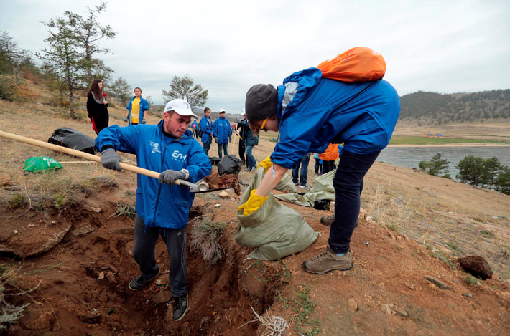
Free Riders
Due to slowness of governmental response local individual are organizing clean-up efforts
Environmentalists swayed a local investor to invest in efforts to create a model prototype for a sewage plant.
Notes:
Photo cred: Volunteers - http://siberiantimes.com/home/voice-of-siberia/pollution-crisis-in-lake-baikal/
Photo cred: People examining damage - http://siberiantimes.com/home/voice-of-siberia/pollution-crisis-in-lake-baikal/

Slide 8
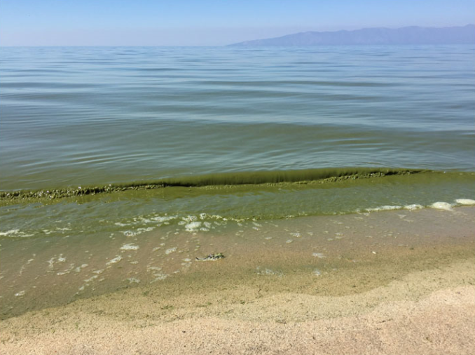
Additional Environmental Threats
Expansion in Tourism Development Projects
Negative externalities:
loss of natural beauty - shoreline erosion
Notes:
Pic Cred- http://siberiantimes.com/ecology/casestudy/features/f0247-if-you-love-baikal-become-a-peoples-scientist-to-save-it-from-stinking-algae/

