Slide 1
“Flight Path Noise: Residents Fight Changes in SFO Approach”
The Mercury News
Sean Maiwald
PPPA 6017
11/22/16

Slide 2
Article Summary
NextGen, an FAA program was launched in the Bay Area in 2012
Three major airports, extremely congested skies (SFO, OAK, SJC)
Residents have concerns over noise issues from airline traffic
Impacts residents of mountain areas that weren’t previously affected.

Slide 3
In Economic Terms
NextGen is a transaction between airlines and the FAA to reduce costs
In short, public good that the FAA provides
Externality ≡ cost or benefit accruing to party not involved in economic transaction
Negative externality ≡ cost accruing to party not involved in economic transaction
Negative externalities for populated areas: noise pollution
Residents of mountain areas
City of Palo Alto; waypoint

Slide 4
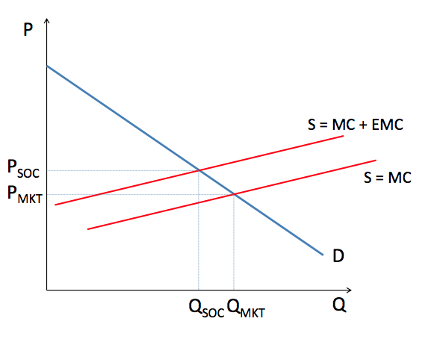
Externalities, Graphed

Slide 5
Conclusion
Negative externalities increases costs for both the FAA and for the airlines
Rerouting planes wastes more fuel
This potentially can increase prices for consumers as airline tickets are heavily dependent on petroleum prices and usage
Potential solution: assume there is a social marginal cost or a cost of abatement
Example: SFO Residential Sound Insulation Program

Slide 6
Sources
http://www.mercurynews.com/2016/08/08/flight-path-noise-residents-fight-changes-in-sfo-approach/
http://www.flysfo.com/community/noise-abatement/residential-sound-insulation-program
http://www.sfgate.com/bayarea/article/test-7945704.php#item-44548
http://leahbrooks.org/leahweb/teaching/pppa6017/2016/subpages/lecture_notes/lecture11_v3.pdf

