Slide 1
Generic Drugmakers Facing Antitrust Inquiry Over Rising Prices
Emily Griswold
11/15/2016
Introductory Microeconomics

Slide 2
Article Summary
The Justice Department is investigating the possibility that many drug manufacturers, such as Teva and Mylan, may be participating in price fixing.
This is an issue because of anti trust laws in place that make it illegal to collude with other companies to maintain market power to a few groups and harm consumers.

Slide 3
Problems for Consumers
If it is true that the main drug manufacturers are colluding and participating in price fixing this is good for the companies but very bad for consumers. By raising prices on the drugs consumers lose the surplus they would have in a competitive market.

Slide 4
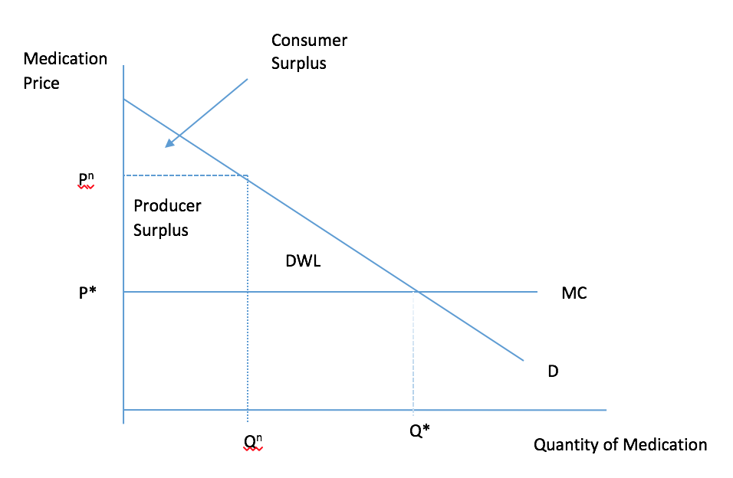
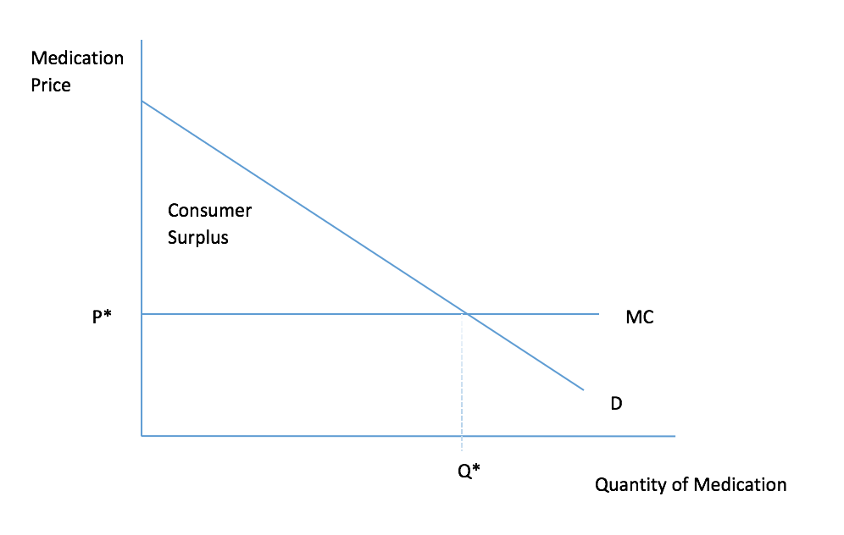
How Price Fixing and Market Power Effect the Consumers
Consumer Surplus without Price Fixing
Consumer Surplus With Price Fixing

