Slide 1
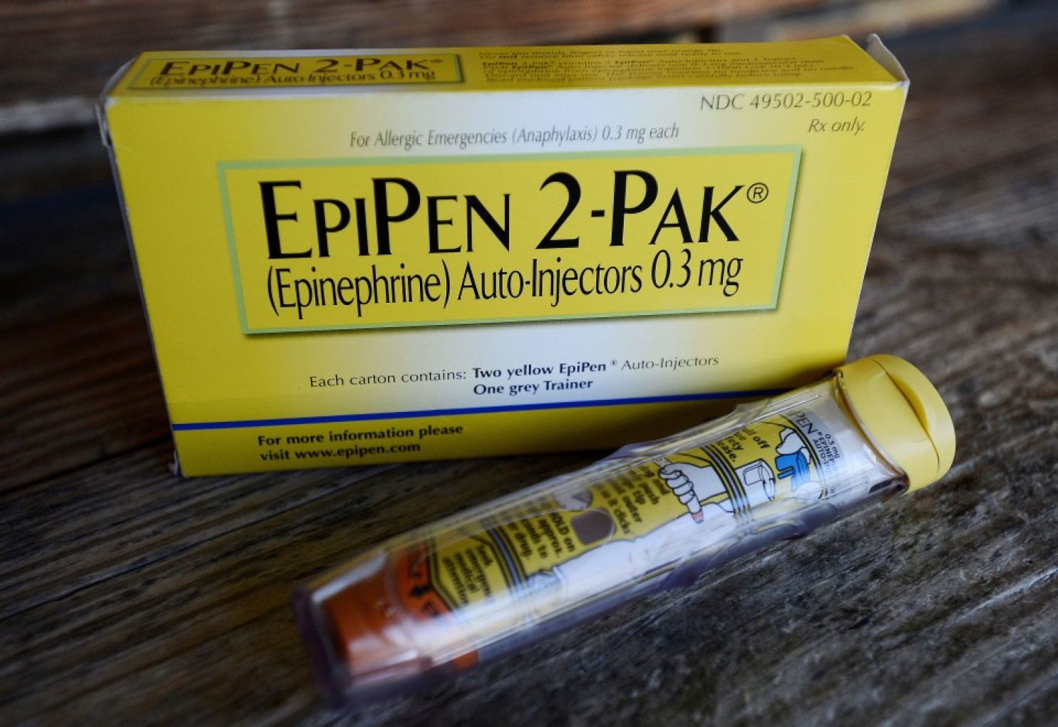
Lawmakers grill mylan CEO over EPiPen price hikes
Danielle Caputo
PPPA 6017-Afternoon

Slide 2
The House Committee on Oversight and Government Reform held hearings to investigate the 500% price increase of EpiPens that has occurred over the last decade
Head of Mylan claims that they are not increasing the price to gain more revenue, but that their costs are so high that they only receive $274 from every $600 EpiPen they sell, and only $100 of that is profit.

Slide 3
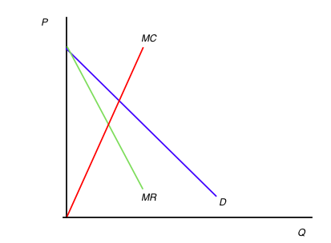
Government Regulation Led to the Creation of a Monopoly
Renewed patent protection
Strict FDA drug-approval process

Slide 4
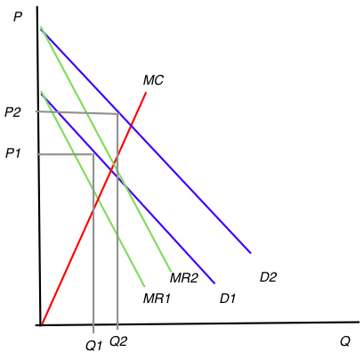
Then Congress passed a law requiring schools to stock epinephrine

Slide 5
Now Congress wants to increase competition in the epinephrine market
Considering easing government barriers to entry
Moving drugs more quickly through FDA approval process
Changing substitution laws to decrease product differentiation in the market
Looking into legality of contracts with schools

