Slide 1
Supply in a Competitive Market: Fort Calhoun Nuclear Power Plant
By: Tahir Alberga

Slide 2
Background
Fort Calhoun nuclear power plant in Nebraska is closing.
The market is competitive and the power plant can no longer maximize its profit.
Other forms of energy production are cheaper (i.e natural gas).

Slide 3
Competition in the Energy Industry
Source: U.S. Energy Information Administration

Slide 4
Results of Competition
Nuclear power has stringent regulations and fixed cost which make it uncompetitive.
Fixed cost include storage.
Nuclear waste has to be stored in concrete casks.

Slide 5
Short Run vs. Long Run
The Fort Calhoun plant has been operating for over 40 years.
Shutting down the plant will cost up to $1.5 billion, and take up to 60 years to complete.
However, Omaha Public Power District believes shutting down is cheaper than keeping the plant in production.

Slide 6
What is Happening?
Nuclear power is a victim of entry.
Nuclear power does not have the same cost curve as natural gas and renewable energy (wind, solar, etc).

Slide 7
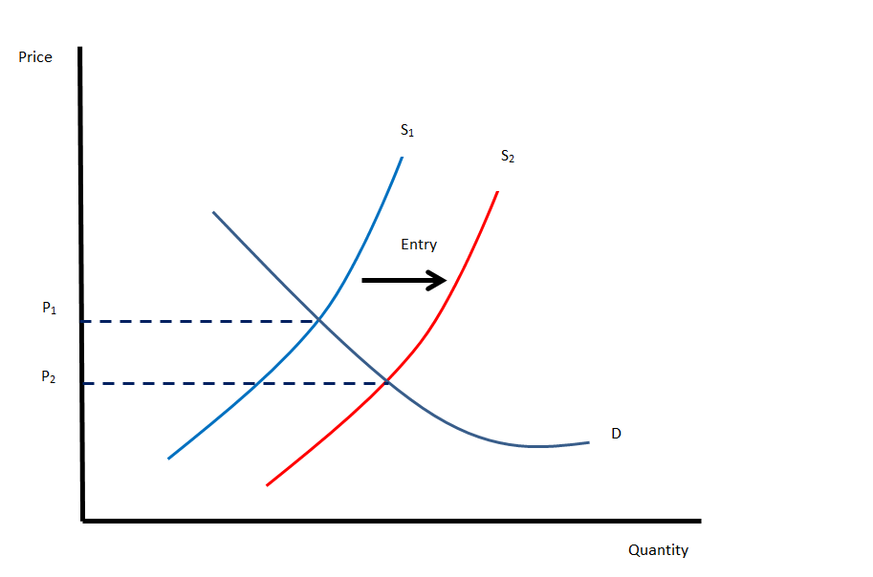
Entry of new sources of energy increases supply and lowers equilibrium price. The nuclear plant cannot operate at the new price and must exit the market.

Slide 8
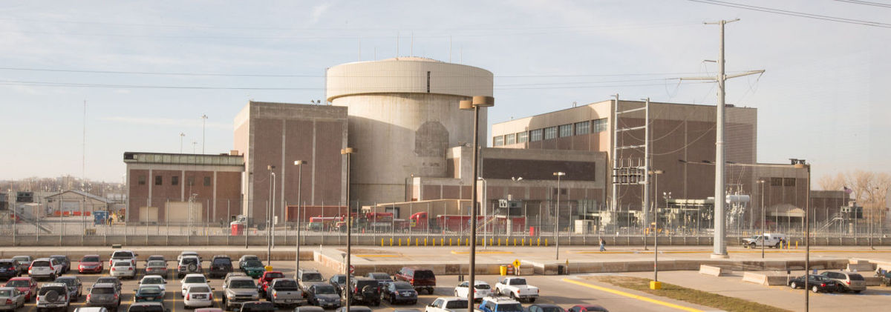
Questions?

