Slide 1
Firm Behavior in the NYC Restaurant Market
Kathryn Sanner
PPPA 6017
November 8, 2016

Slide 2
Summary
New York Times article: “Is New York Too Expensive for Restaurateurs? We Do the Math”
The article tested the hypothesis that it is more expensive for an independently owned restaurant to operate and stay afloat in New York City.
New York’s real estate (cost of rent/sq. ft.), labor (employee wages), and food supply costs were compared with those in Los Angeles and San Francisco.
Across all categories, New York City was the most expensive location.

Slide 3
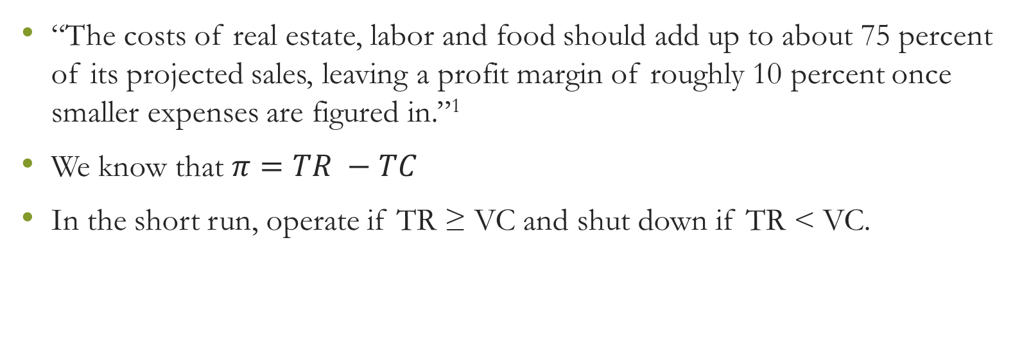
Formula for Success
“The costs of real estate, labor and food should add up to about 75 percent of its projected sales, leaving a profit margin of roughly 10 percent once smaller expenses are figured in.”¹
We know that $π=TR −TC$
In the short run, operate if TR ≥ VC and shut down if TR < VC.

Slide 4
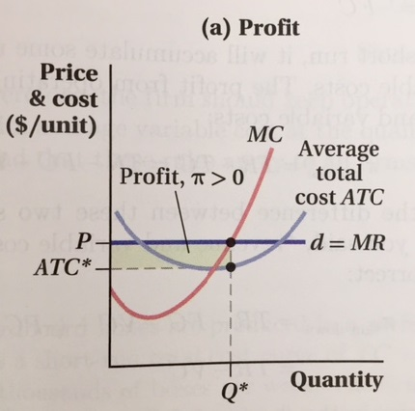
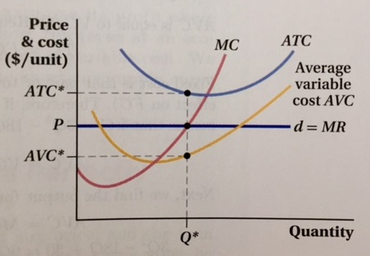

In the short run…
$$π=10\%$$

Slide 5
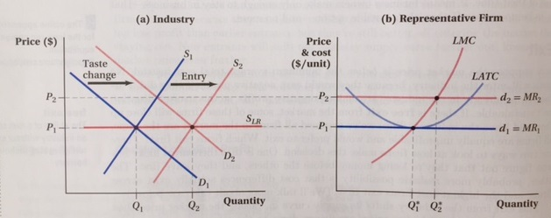
In the long run…
Taste change = consumer preference shift to cheaper “quick service” restaurants

