Slide 1
The Increasing Costs of Chocolate Production
By Haley Dunn

Slide 2
Summary of Article
Focuses on chocolate production, specifically Hershey company
Due to harvest issues, cost of cocoa butter has increased dramatically (+21% over last year)
Raw sugar production levels also fallen, increasing its cost
Both are key inputs in the manufacture of chocolate

Slide 3
What does this mean for Hershey?
Because the cost of inputs rose, marginal cost, average variable cost, and average total cost for producing additional chocolate bar increase
Interesting factors:
Cost of inputs = small fraction of total cost of chocolate production
Due to changing consumer preferences for healthier snack bars, Hershey’s market is more elastic- it will absorb the increased cost instead of passing it to consumers by raising prices¹

Slide 4
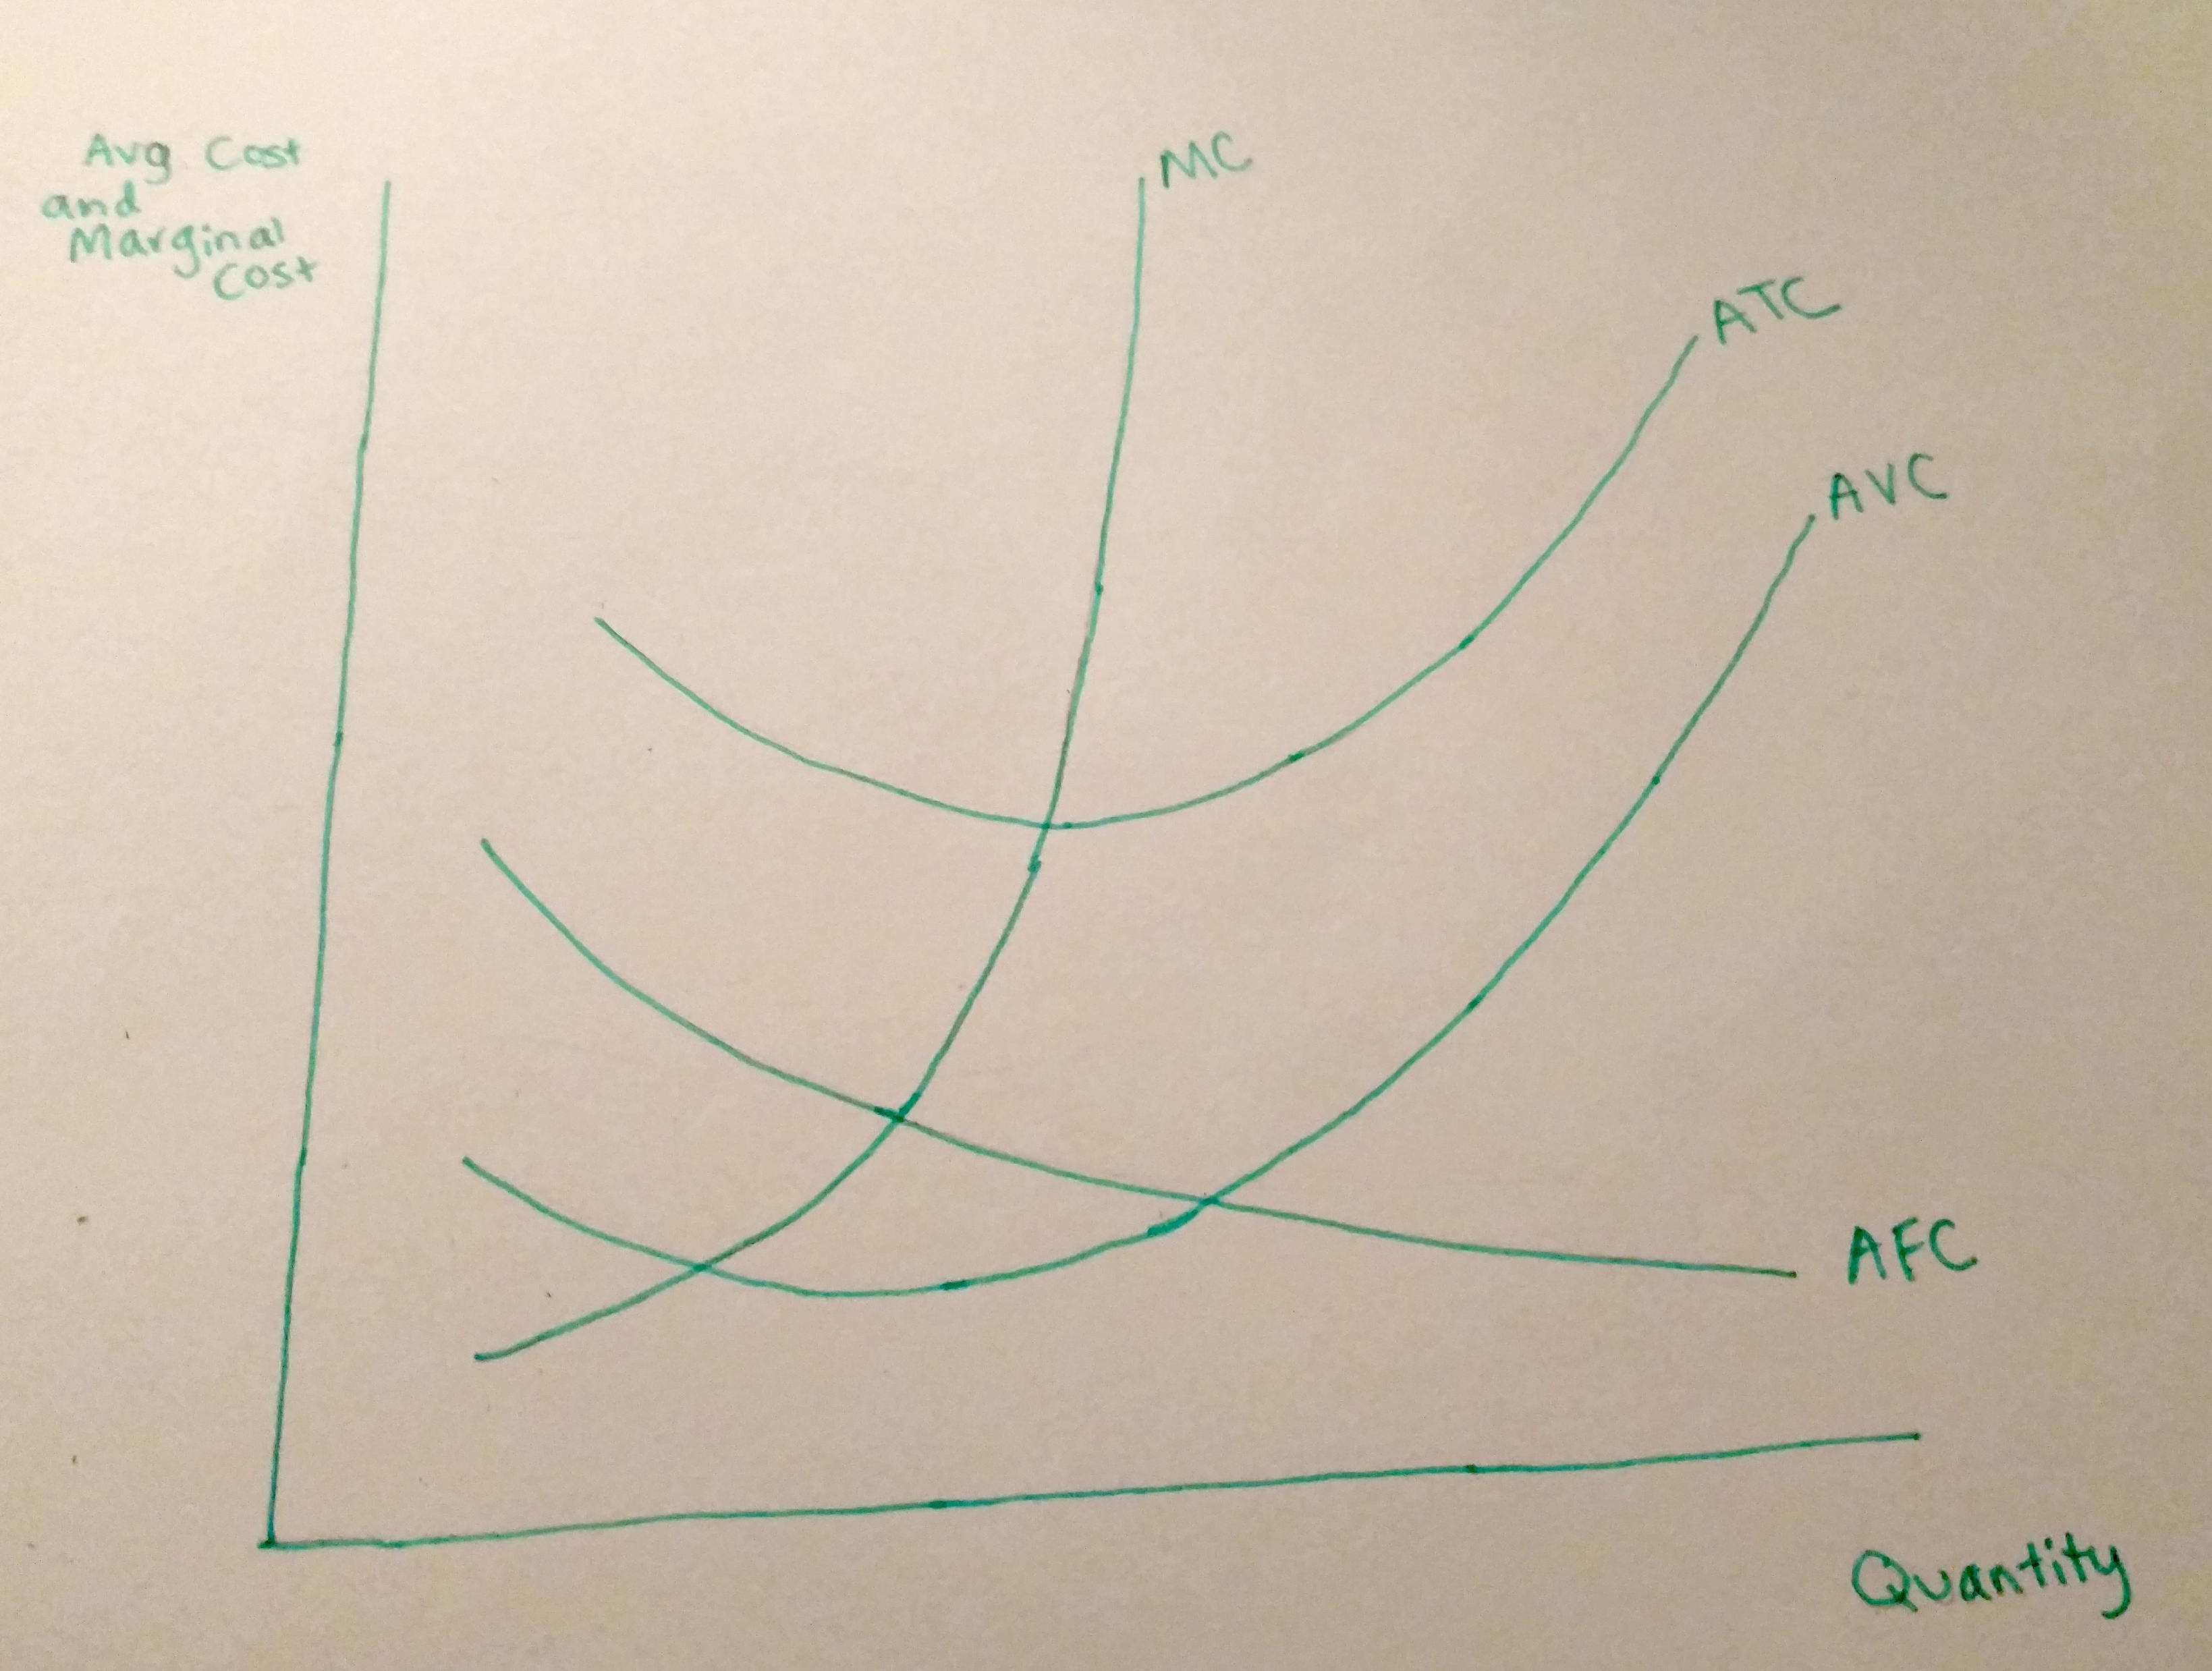
Changes in Cost Curves
Original cost curves (short run)

Slide 5
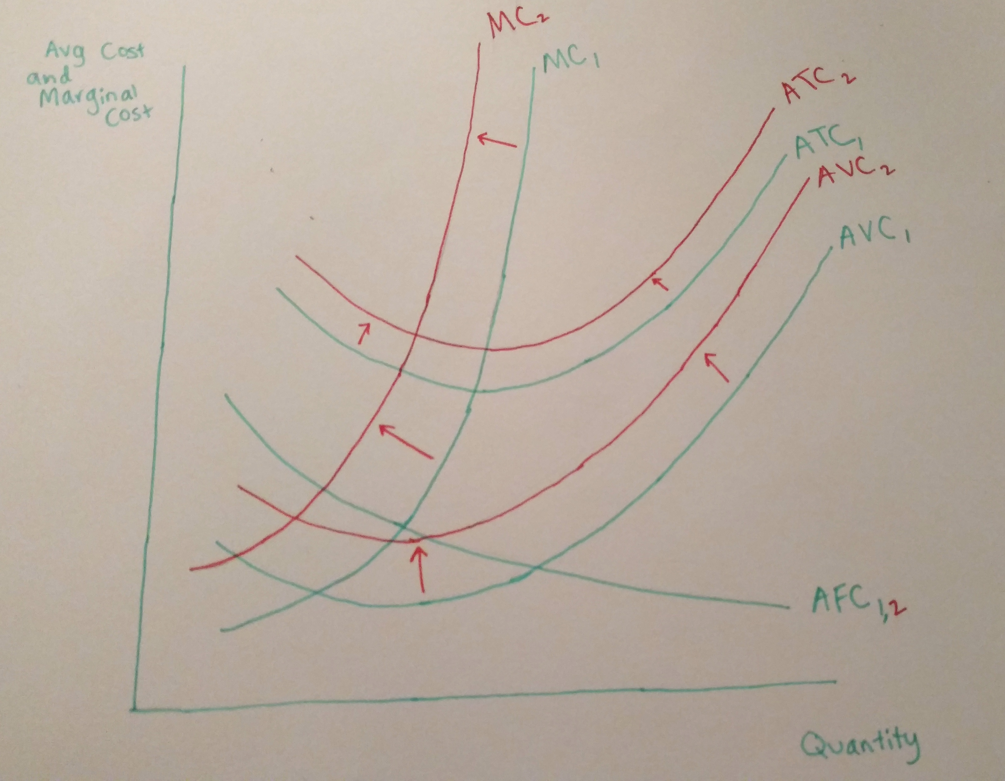
Changes in Cost Curves
New cost curves (short run)

Slide 6
Long-term Options
Hershey could decide that this is a relatively short term trend and not cut production
Hershey could choose to reduce costs in another section of their production, e.g. more cost-efficient transportation or marketing
Hershey could produce less chocolate and more products that are not affected
Hershey could increase prices anyway; perhaps loss in revenue will be less than the additional costs

Slide 7
Source:
¹ Wernau, Julie. "Higher Costs Bite Chocolate Makers." The Wall Street Journal, July 11, 2016. Accessed October 20, 2016. http://www.wsj.com/articles/higher-costs-bite-chocolate-makers-1468280462.

