Slide 1
Consumer Income and Market Elasticity
Amanda Swanson

Slide 2
Quick Recap
Median U.S. household income rose 5.2% from 2014 to 2015
Largest gains in lower-income households, followed by middle class
Smallest gains in the upper class
Expect marked increases in consumer spending
Estimated 60% of American households spend entirety of income (Merrill Lynch)

Slide 3
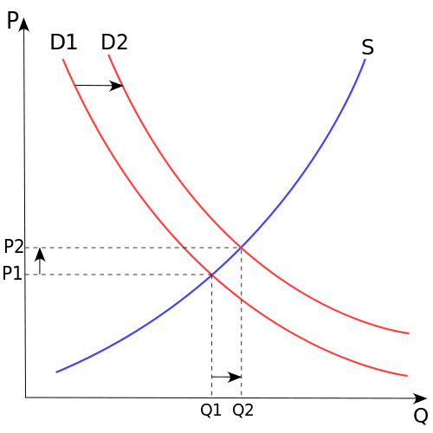
Income Elasticity of Demand
Elasticity of the consumer market is a positive value
Increased income will lead to increased consumer spending (Lahart)
How do we expect the market to respond?
General demand curve for consumer goods will shift to the right
New market equilibrium will occur at higher price and quantity
Consumption of normal and luxury goods will increase; it is probable that consumption of inferior goods will decrease
Retrieved from https://en.wikipedia.org/wiki/Demand_curve

